Slide 1
Lecture 4
ITEC618
Program Control Structures: Selections and Loops II
Programming Concepts
Lecturer: Dr. Farshid Keivanian

Slide 2
Which Loop to Use?
In programming, you have three types of loop statements: while, do-while, and for. These loops are expressively equivalent, meaning you can achieve the same functionality using any of these three loops, depending on the situation. For instance, a while loop can always be transformed into a for loop and vice versa, depending on how you structure your loop conditions and actions.
For example, if you are tasked with iterating over a collection of items in a program, you can use either a while loop or a for loop, depending on which structure is more intuitive for your specific case.

Slide 3
Which Loop to Use?
Concept Introduction
Loop Structures: Before diving into different loop structures (while, do-while, for), it's essential to understand that loops are used to execute a block of code repeatedly, based on a condition. Loops can simplify repetitive tasks, making your code more efficient and readable.
Practical Scenario Presentation
Scenario: Imagine you are working on a project at Canva in Melbourne, where you need to create a feature that generates a report for active users. You can use a for loop to iterate through the list of users and only include those with an "active" status in the report. However, if your list might dynamically change or grow, you might prefer a while loop to handle the iteration, giving you more control over the loop's termination.

Slide 4
Which Loop to Use?
Class Discussion Question: How would you choose between using a for loop and a while loop when iterating through a list of users whose status can change during the iteration?
Responses:
"I would use a for loop if the list size is fixed, as it makes the loop more concise."
"I might prefer a while loop if I need to check or update the list's condition dynamically during the loop."

Slide 5
Which Loop to Use?
Multiple-Choice Question
Which of the following is true about for loops and while loops?
A) A for loop can only be used with a fixed number of iterations. B) A while loop continues until a condition becomes false, regardless of how many iterations. C) A for loop cannot be converted into a while loop. D) For loops and while loops are not expressively equivalent.

Slide 6
Which Loop to Use?
The three forms of loop statements, while, do-while, and for, are expressively equivalent; that is, you can write a loop in any of these three forms. For example, a while loop in (a) in the following figure can always be converted into the following for loop in (b):
A for loop in (a) in the following figure can generally be converted into the following while loop in (b):

Slide 7
switch Statements
Introduction to switch Statements
In programming, a switch statement allows you to execute one block of code among many based on the value of a variable. It's a clean way to handle multiple conditions, especially when you have a single variable that can take on a limited set of possible values. The switch statement evaluates the expression and compares it with the values of each case. When a match is found, the corresponding block of code is executed.

Slide 8
switch Statements
Practical Scenario Presentation
Scenario: Imagine you are working at Qantas in Sydney, and you need to develop a flight scheduling system that assigns a specific process based on the month. Depending on the month, the system should perform different actions, such as updating winter or summer schedules, handling holiday traffic, or planning for peak travel seasons.
For example, in January (case 1), the system should prepare for summer holiday schedules in Australia, while in December (case 12), it should prepare for Christmas travel surges.

Slide 9
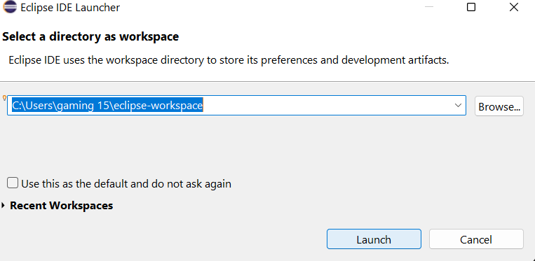
switch Statements
Here's how you might implement this logic using a switch statement:

Slide 10
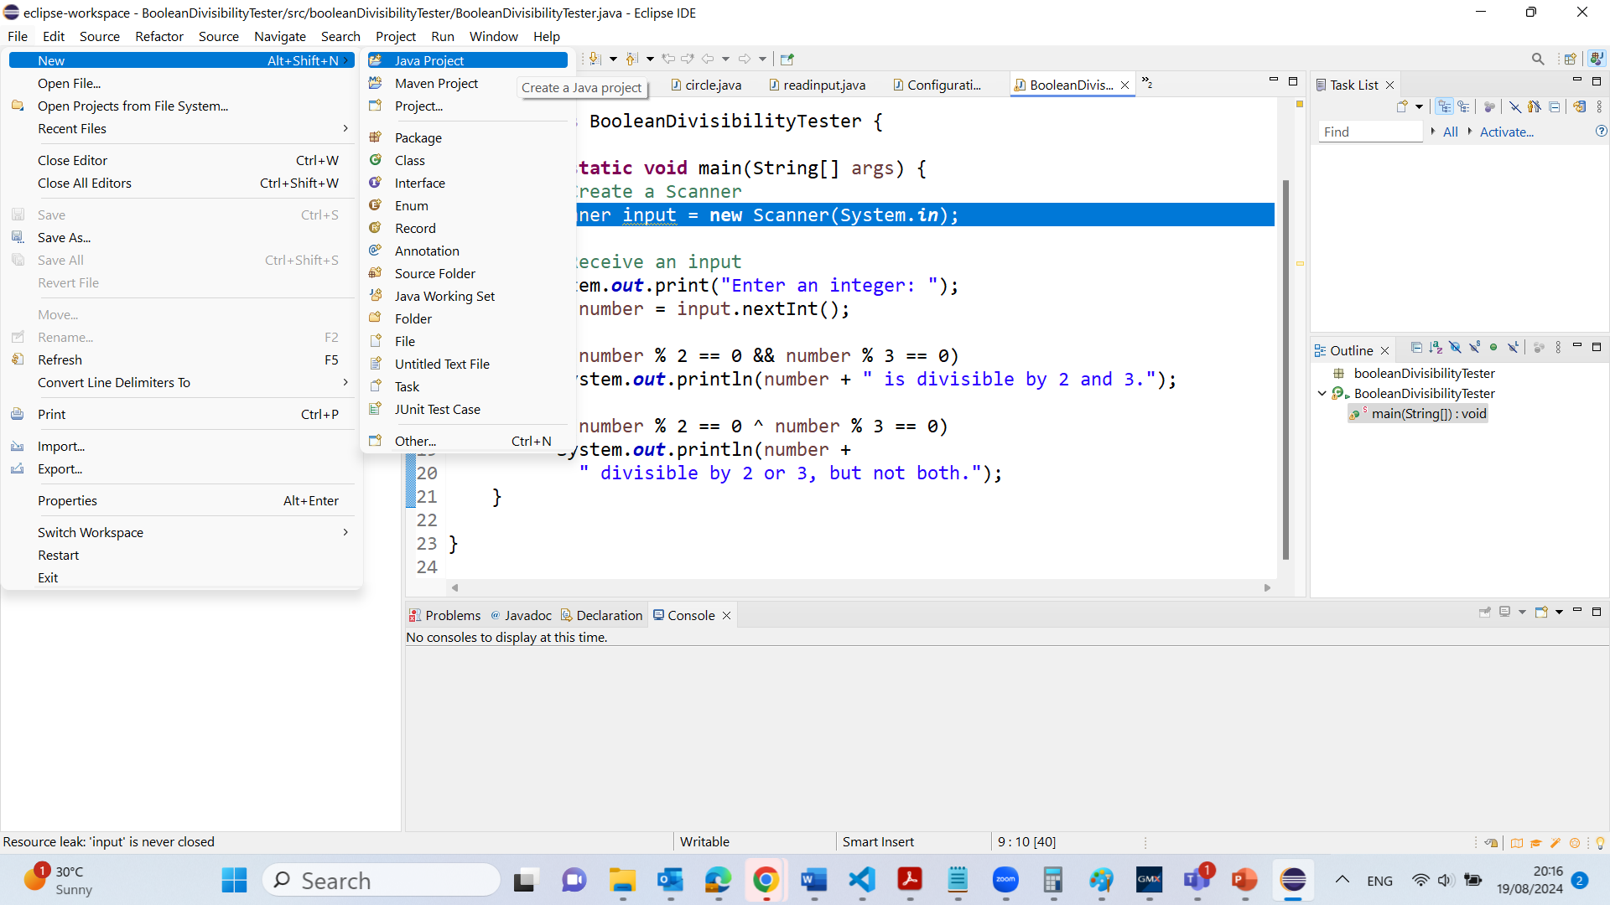
switch Statements

Slide 11
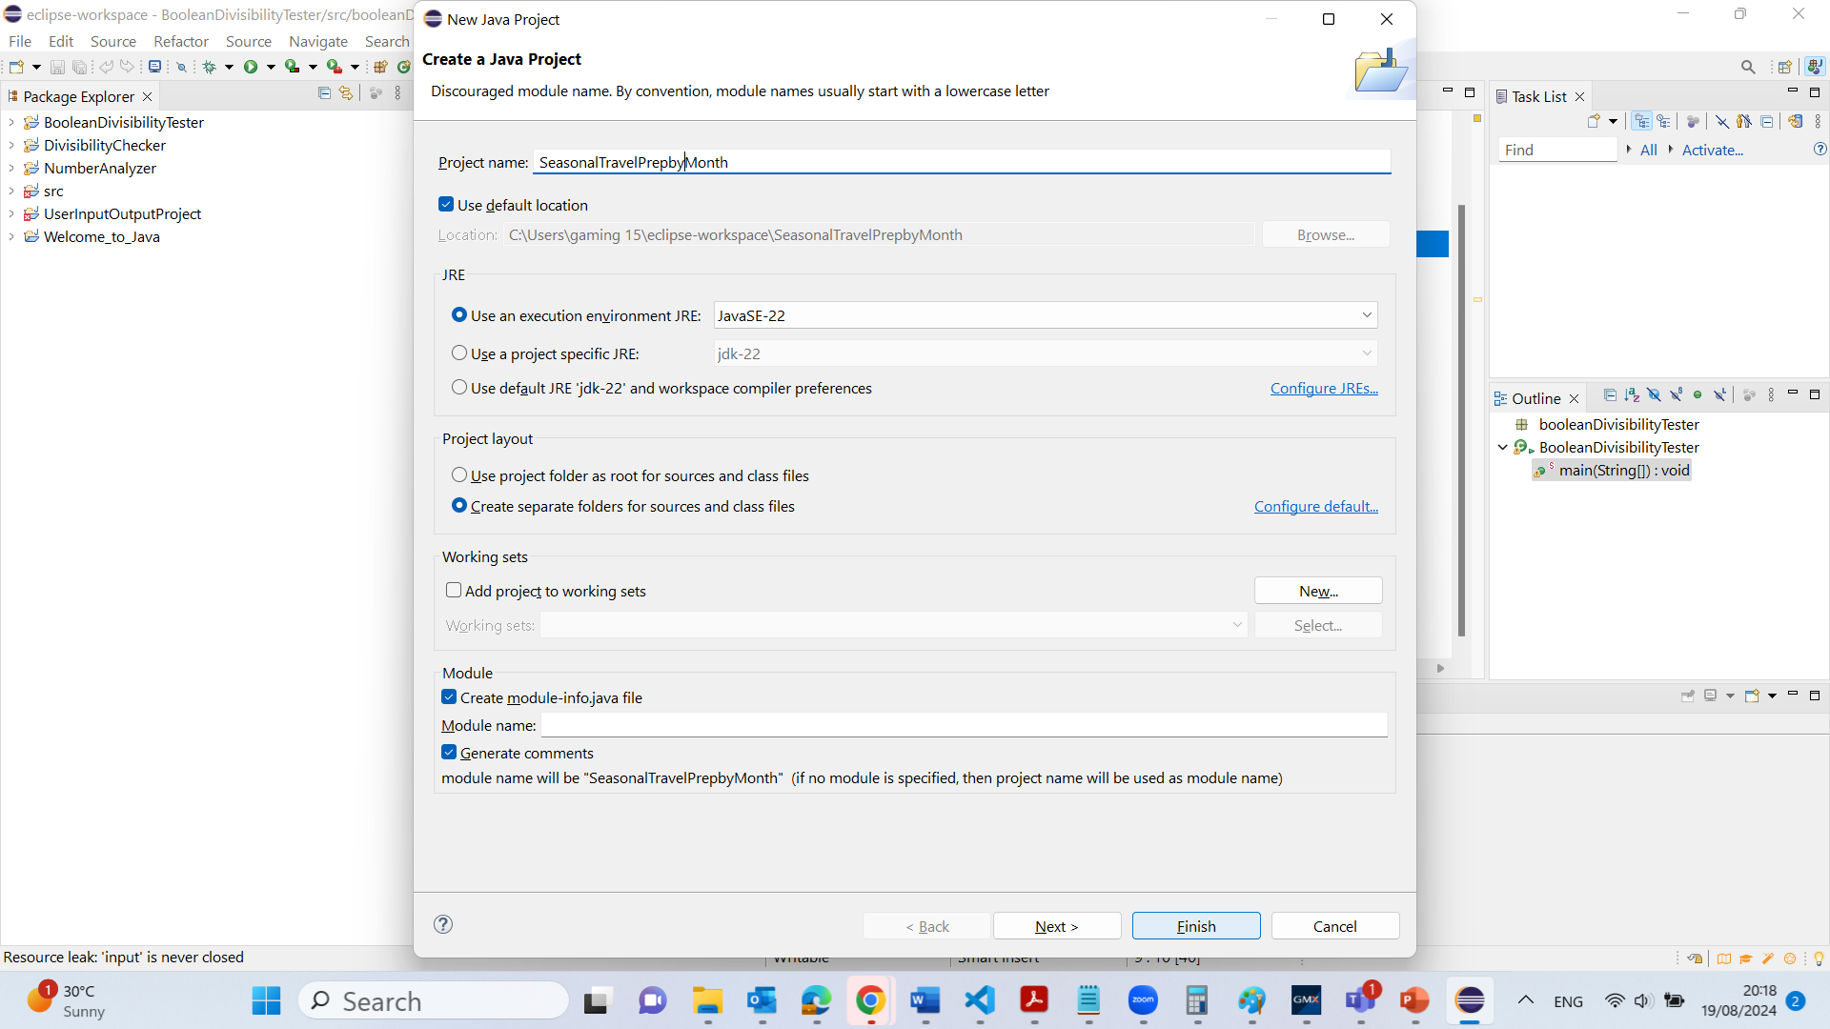
switch Statements

Slide 12
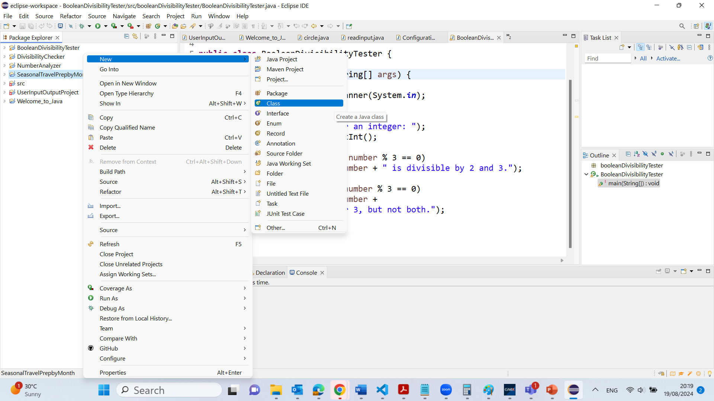
switch Statements

Slide 13
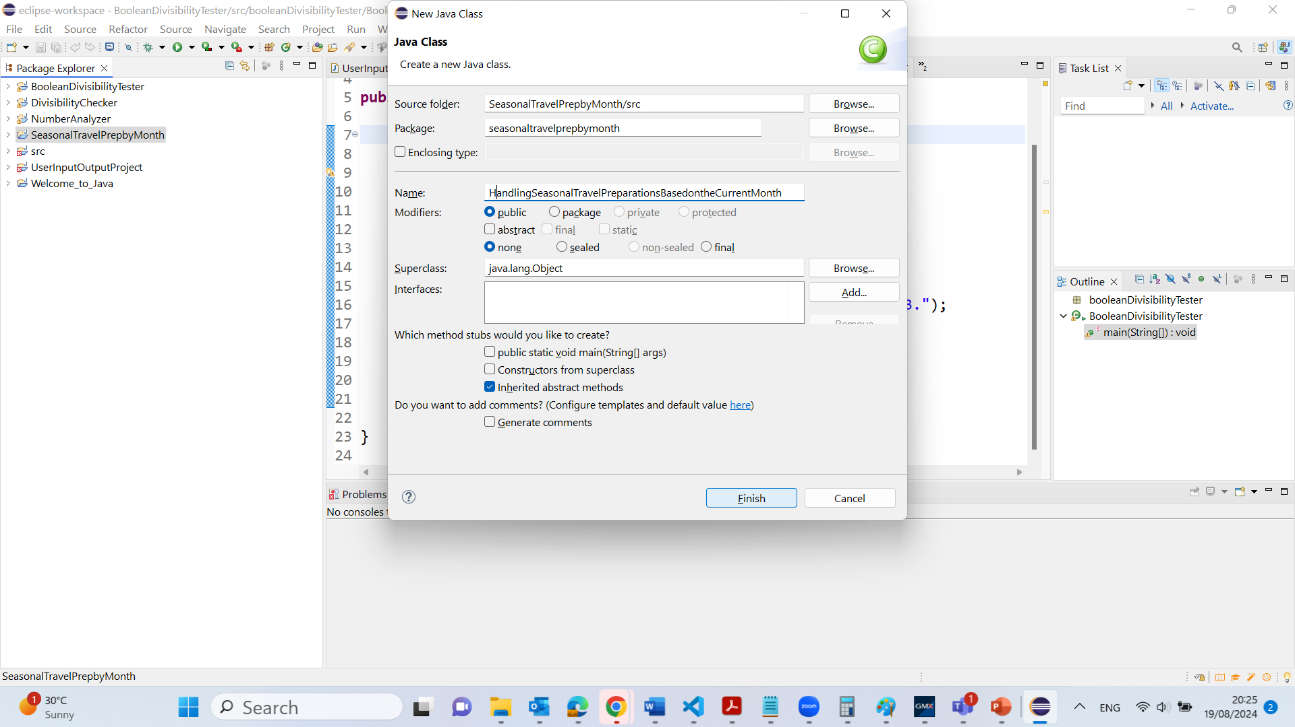
switch Statements

Slide 14
package seasonaltravelprepbymonth;
public class HandlingSeasonalTravelPreparationsBasedontheCurrentMonth {
public static void main(String[] args) {
int month = getCurrentMonth();
switch (month) {
case 1:
System.out.println("Prepare for summer holiday schedules.");
break;
case 2:
System.out.println("Monitor school holiday travel.");
break;
case 12:
System.out.println("Prepare for Christmas travel surge.");
break;
default:
System.out.println("Invalid month.");
System.exit(1);
}
}
public static int getCurrentMonth() {
// This method should return the current month as an integer.
// For example, return 1 for January, 2 for February, etc.
// Here it's assumed that this method is implemented elsewhere.
return 1; // Example return value for demonstration
}
}

Slide 15
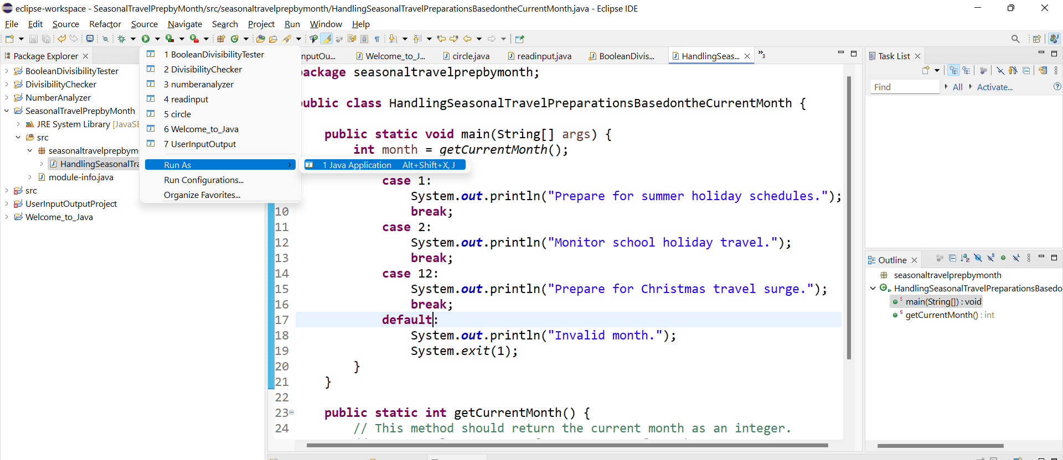

Slide 16
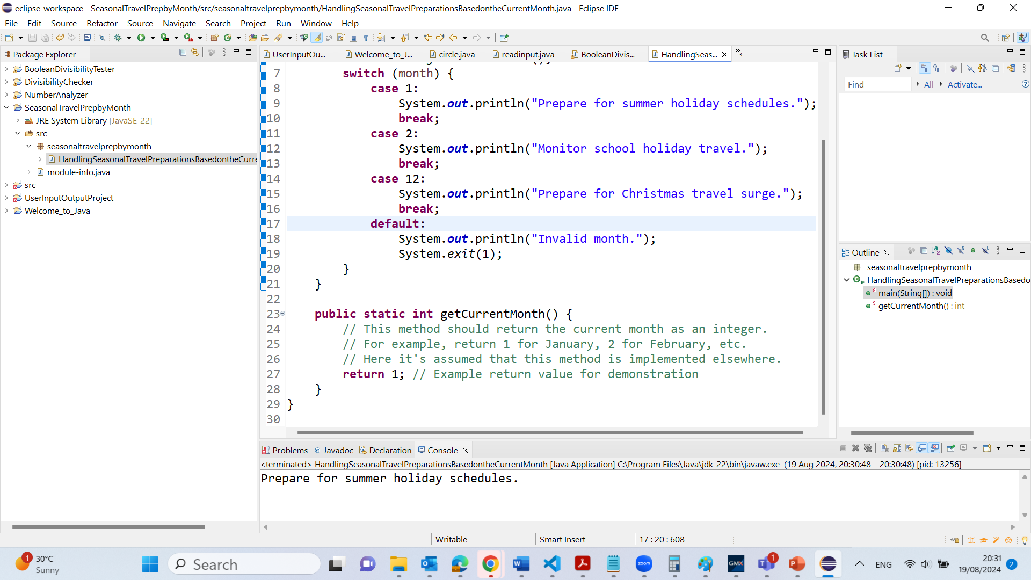

Slide 17
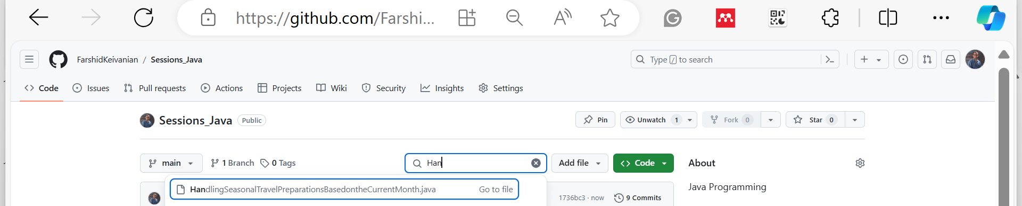
C:\Users\...\eclipse-workspace\SeasonalTravelPrepbyMonth\src\seasonaltravelprepbymonth

Slide 18
switch Statements
switch (rmonth) {
case 1: print Janurary;
break;
case 2: print Feburary;
break;
case 3: print March;
break;
…
case 12: print December;
break;
default: System.out.println("Errors: invalid status");
System.exit(1);
}

Slide 19
switch Statements
Class Discussion Question: How would you handle a situation where the month value might be invalid, such as a negative number or a number greater than 12?
Responses:
"I would use the default case in the switch statement to catch any invalid month values."
"I could add input validation before the switch statement to ensure the month is within the valid range."

Slide 20
switch Statement Rules
The switch-expression must yield a value of char, byte, short, or int type and must always be enclosed in parentheses.
switch (switch-expression) {
case value1: statement(s)1;
break;
case value2: statement(s)2;
break;
…
case valueN: statement(s)N;
break;
default: statement(s)-for-default;
}
The value1, ..., and valueN must have the same data type as the value of the switch-expression.
The resulting statements in the case statement are executed when the value in the case statement matches the value of the switch-expression.
Note that value1, ..., and valueN are constant expressions, meaning that they cannot contain variables in the expression, such as 1 + x.

Slide 21
switch Statement Rules
The keyword break is optional, but it should be used at the end of each case in order to terminate the remainder of the switch statement.
If the break statement is not present, the next case statement will be executed.
switch (switch-expression) {
case value1: statement(s)1;
break;
case value2: statement(s)2;
break;
…
case valueN: statement(s)N;
break;
default: statement(s)-for-default;
}
The default case, which is optional, can be used to perform actions when none of the specified cases matches the switch-expression.
When the value in a case statement matches the value of the switch-expression, the statements starting from this case are executed until either a break statement or the end of the switch statement is reached.

Slide 22
Trace switch statement
Multiple-Choice Question: What happens if there is no break statement at the end of a case block in a switch statement?
A) The program will throw an error. B) The program will exit the switch statement and continue executing the rest of the code. C) The program will continue executing the next case block(s) until it encounters a break statement or the end of the switch statement. D) The program will stop executing immediately.
Suppose day is 2:
switch (day) {
case 1:
case 2:
case 3:
case 4:
case 5: System.out.println("Weekday"); break;
case 0:
case 6: System.out.println("Weekend");
}

Slide 23
Trace switch statement
Match case 2
switch (day) {
case 1:
case 2:
case 3:
case 4:
case 5: System.out.println("Weekday"); break;
case 0:
case 6: System.out.println("Weekend");
}

Slide 24
Trace switch statement
Fall through case 3
switch (day) {
case 1:
case 2:
case 3:
case 4:
case 5: System.out.println("Weekday"); break;
case 0:
case 6: System.out.println("Weekend");
}

Slide 25
Trace switch statement
Fall through case 4
switch (day) {
case 1:
case 2:
case 3:
case 4:
case 5: System.out.println("Weekday"); break;
case 0:
case 6: System.out.println("Weekend");
}

Slide 26
Trace switch statement
Fall through case 5
switch (day) {
case 1:
case 2:
case 3:
case 4:
case 5: System.out.println("Weekday"); break;
case 0:
case 6: System.out.println("Weekend");
}

Slide 27
Trace switch statement
Encounter break
switch (day) {
case 1:
case 2:
case 3:
case 4:
case 5: System.out.println("Weekday"); break;
case 0:
case 6: System.out.println("Weekend");
}

Slide 28
Trace switch statement
Exit the statement
switch (day) {
case 1:
case 2:
case 3:
case 4:
case 5: System.out.println("Weekday"); break;
case 0:
case 6: System.out.println("Weekend");
}

Slide 29
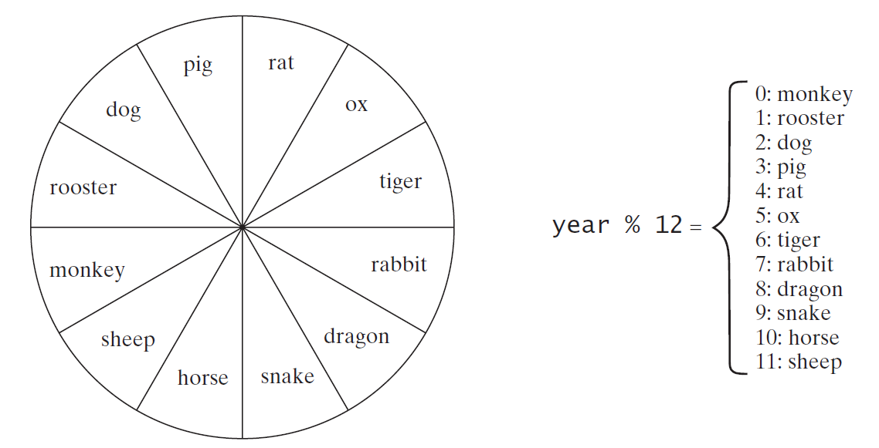
Problem: Chinese Zodiac
Write a program that prompts the user to enter a year and displays the animal for the year.
ChineseZodiac

Slide 30
Problem: Chinese Zodiac
Introduction to the Chinese Zodiac and Modular Arithmetic
Before diving into this problem, let's briefly explore the concept of the Chinese Zodiac and how modular arithmetic is used in programming to solve related problems. The Chinese Zodiac is a cycle of 12 years, each associated with a specific animal. When given a year, you can determine the corresponding animal by calculating the remainder when the year is divided by 12. This remainder, known as the modulus, is a key concept in modular arithmetic.
Practical Scenario Presentation
Scenario: Imagine you are working on a cultural awareness application for Tourism Australia. The app is designed to help tourists learn about the Chinese Zodiac. You need to write a program that allows users to input any year, and the app will display the corresponding animal from the Chinese Zodiac. This feature could be particularly popular in Sydney, where events like the Chinese New Year are celebrated with enthusiasm.

Slide 31
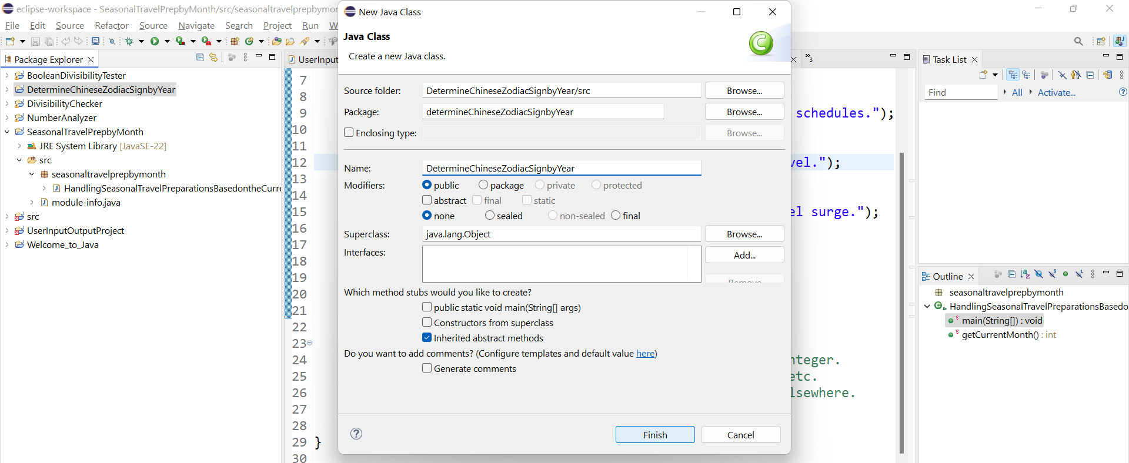
Problem: Chinese Zodiac

Slide 32
Problem: Chinese Zodiac
package determineChineseZodiacSignbyYear;
public class DetermineChineseZodiacSignbyYear {
public static void main(String[] args) {
try (java.util.Scanner input = new java.util.Scanner(System.in)) {
System.out.println("Enter a year:");
int year = input.nextInt();
int zodiacIndex = year % 12;
String[] zodiacs = {
"Monkey", "Rooster", "Dog", "Pig",
"Rat", "Ox", "Tiger", "Rabbit",
"Dragon", "Snake", "Horse", "Sheep"
};
System.out.println("The year " + year + " is the year of the " + zodiacs[zodiacIndex] + ".");
}
}
}

Slide 33
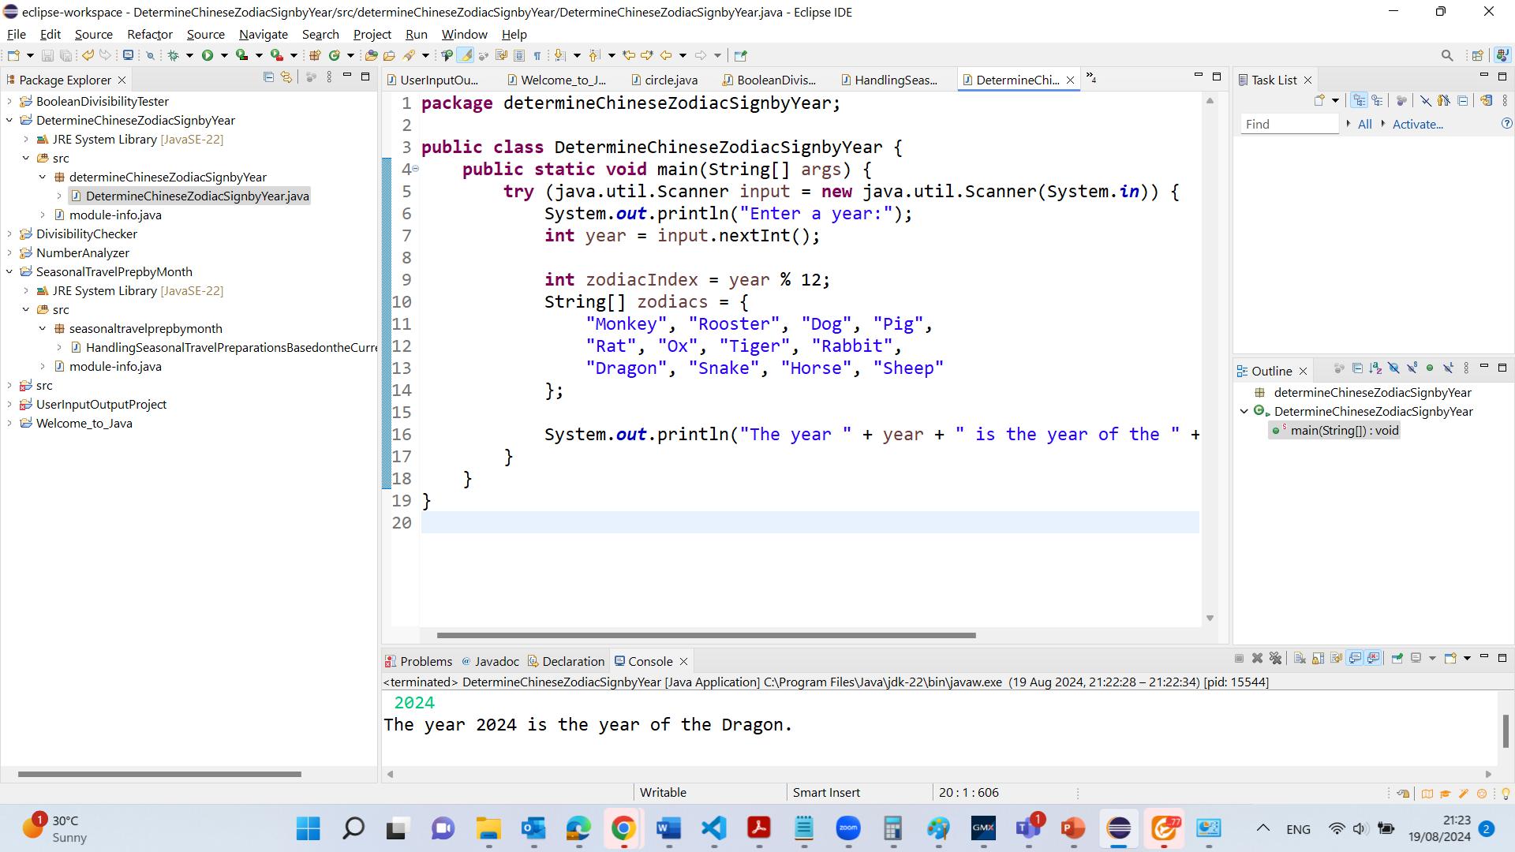
Problem: Chinese Zodiac
This Java program calculates the Chinese Zodiac sign for a given year. It prompts the user to enter a year, then uses the modulo operation (year % 12) to determine the corresponding zodiac sign from an array of zodiac names. The result is printed, informing the user of the zodiac sign associated with the entered year. The Scanner object used for input is automatically closed using the try-with-resources statement.

Slide 34
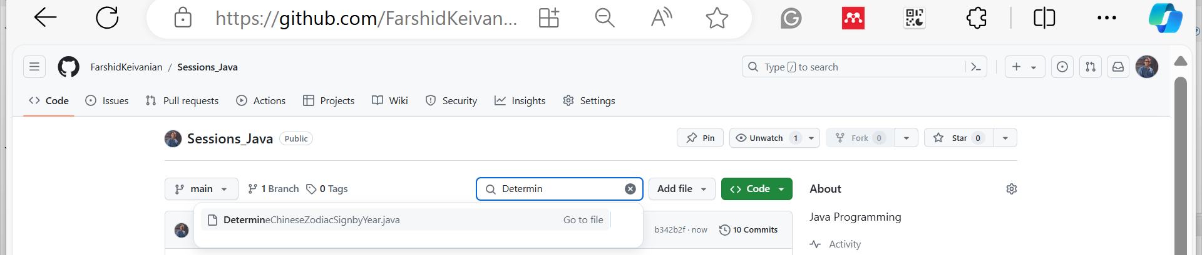
Problem: Chinese Zodiac

Slide 35
Problem: Chinese Zodiac
Class Discussion Question
What would happen if a user enters a negative year, and how would you modify the program to handle such cases?
Responses:
The program would still calculate a valid modulus because the % operator works with negative numbers in Java. However, the output might not make sense in the context of the Chinese Zodiac because the traditional zodiac signs are based on positive year values.

Slide 36
Problem: Chinese Zodiac
Class Discussion Question
What would happen if a user enters a negative year, and how would you modify the program to handle such cases?
Responses:
To handle negative years, I might consider adjusting the year value before calculating the modulus. One approach is to ensure that the year is positive by adding a multiple of 12 until the year is non-negative.

Slide 37
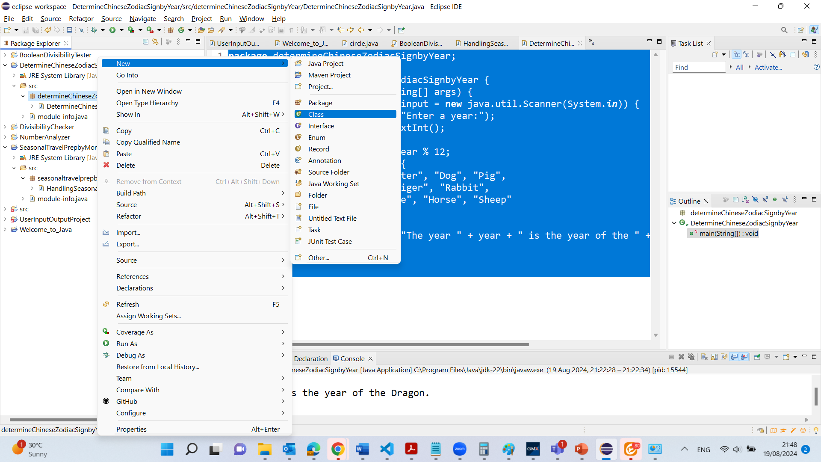
Problem: Chinese Zodiac

Slide 38
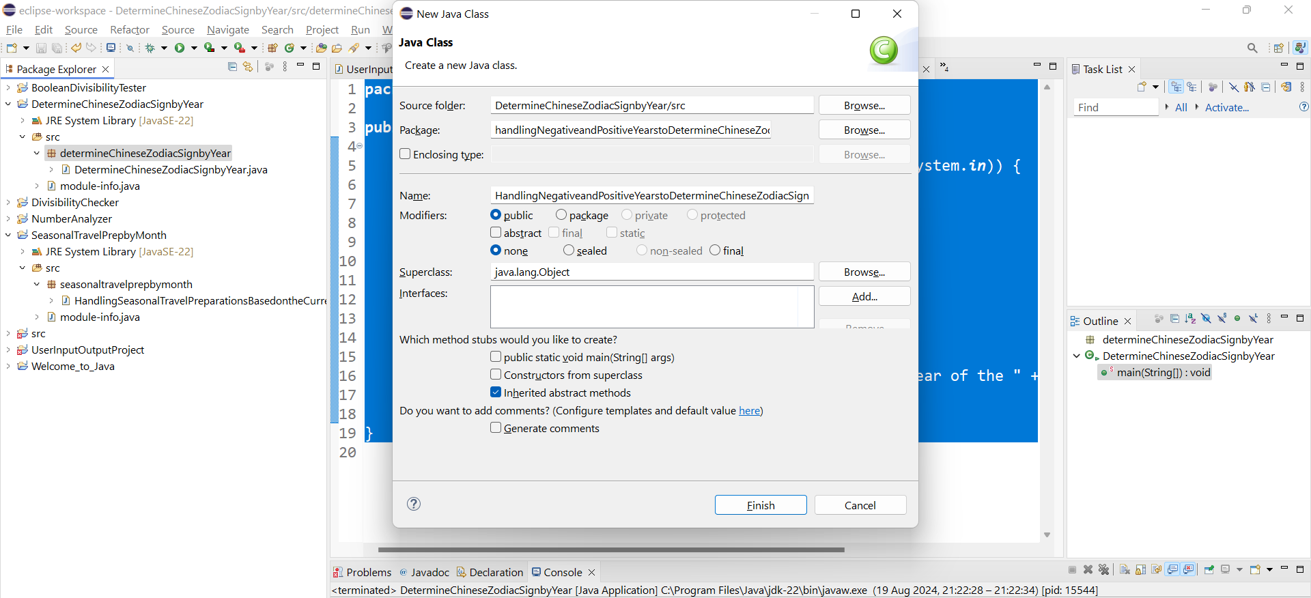
Problem: Chinese Zodiac

Slide 39
Problem: Chinese Zodiac
package handlingNegativeandPositiveYearstoDetermineChineseZodiacSign;
public class HandlingNegativeandPositiveYearstoDetermineChineseZodiacSign {
public static void main(String[] args) {
try (java.util.Scanner input = new java.util.Scanner(System.in)) {
System.out.println("Enter a year:");
int year = input.nextInt();
// Adjust the year to ensure it is non-negative
while (year < 0) {
year += 12;
}
int zodiacIndex = year % 12;
String[] zodiacs = {
"Monkey", "Rooster", "Dog", "Pig",
"Rat", "Ox", "Tiger", "Rabbit",
"Dragon", "Snake", "Horse", "Sheep"
};
System.out.println("The year " + year + " is the year of the " + zodiacs[zodiacIndex] + ".");
}
}
}
Handling Negative Years: The modification adds a while loop that adjusts negative years by adding 12 repeatedly until the year becomes non-negative. This ensures that the modulus calculation works as intended for the Chinese Zodiac, which typically uses positive year numbers.

Slide 40
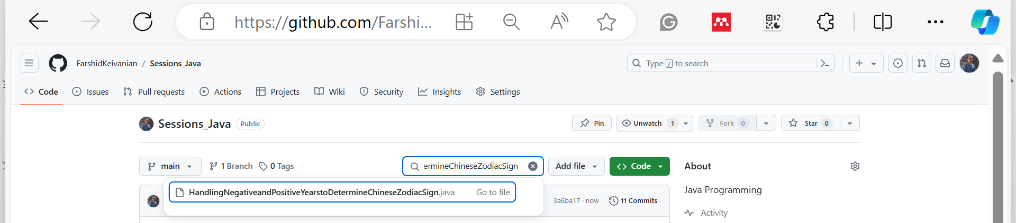
Problem: Chinese Zodiac

Slide 41
Nested Loops
Problem: Write a program that uses nested for loops to print a multiplication table.
MultiplicationTable

Slide 42
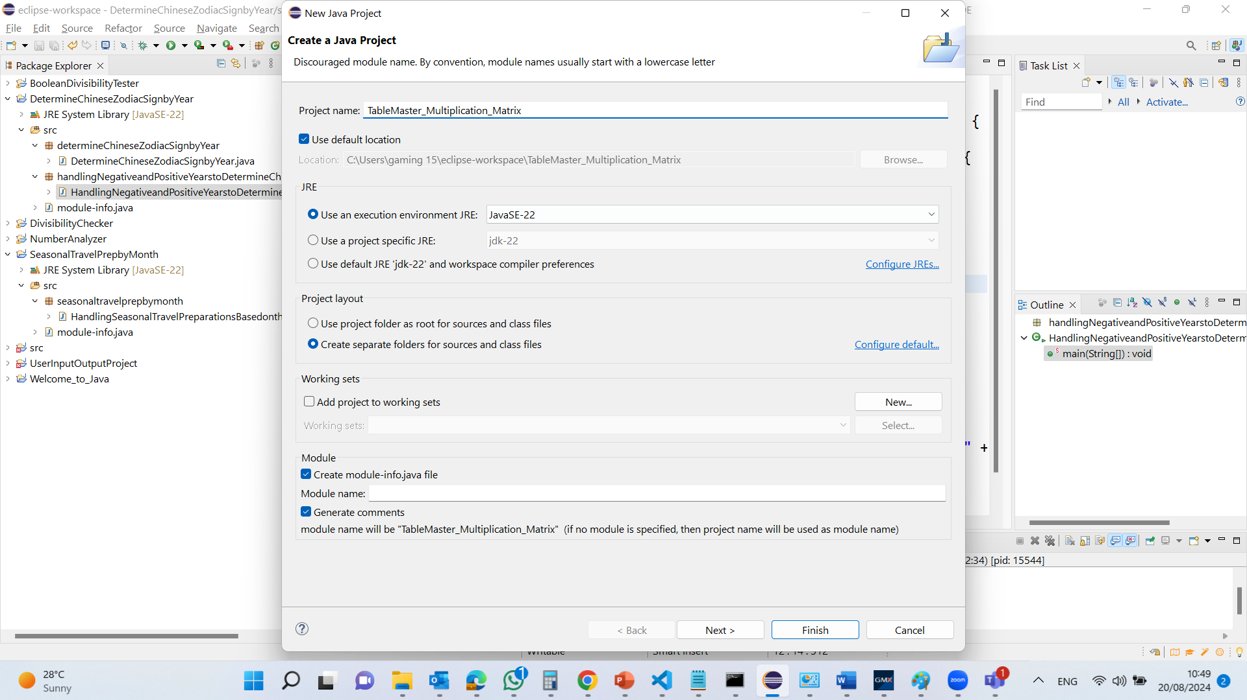
Nested Loops

Slide 43
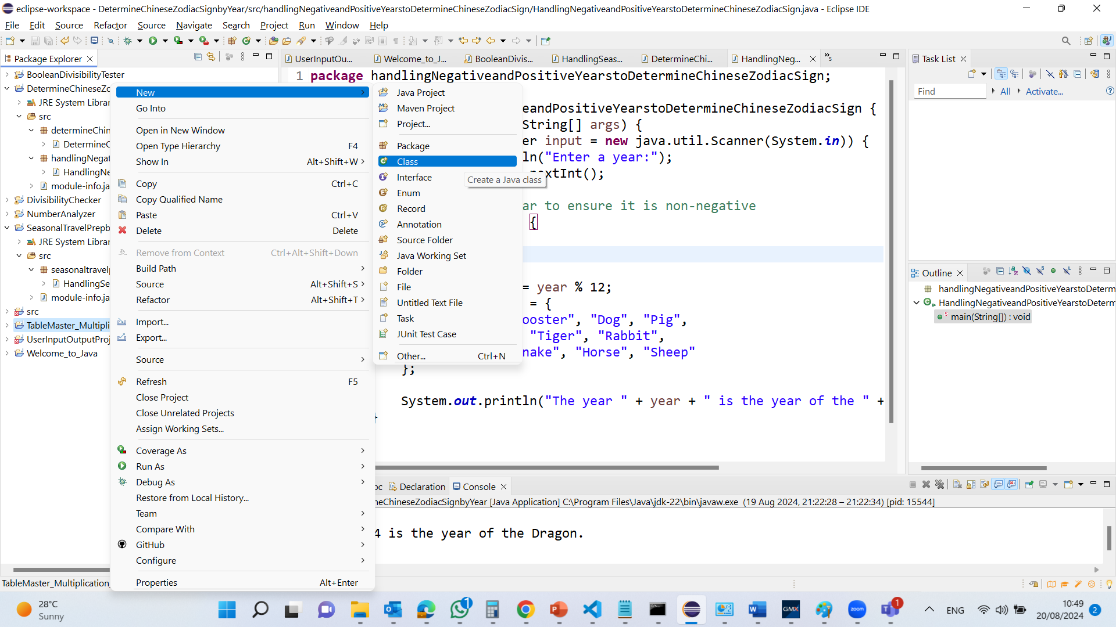
Nested Loops

Slide 44
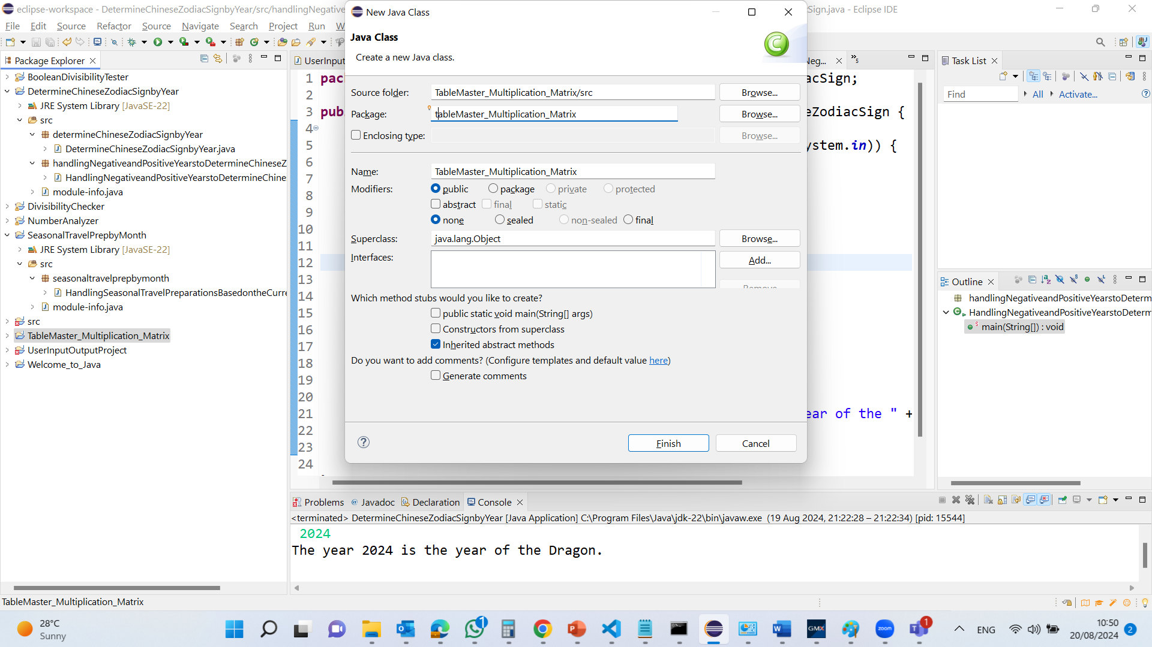
Nested Loops

Slide 45
package tableMaster_Multiplication_Matrix; public class TableMaster_Multiplication_Matrix {
public static void main(String[] args) {
// Display the table heading
System.out.println(" Multiplication Table");
// Display the number title (1 to 9)
System.out.print(" ");
for (int j = 1; j <= 9; j++) {
System.out.print(" " + j);
}
// Print a separator line
System.out.println("\n-----------------------------------------");
// Print the body of the multiplication table
for (int i = 1; i <= 9; i++) { // Outer loop for rows (1 to 9)
System.out.print(i + " | "); // Print the row header
for (int j = 1; j <= 9; j++) { // Inner loop for columns (1 to 9)
// Print the product of the current row and column, formatted with spaces
System.out.printf("%4d", i * j);
}
// Move to the next line after printing all columns for the current row
System.out.println();
}
}
}
Table Heading:
System.out.println(" Multiplication Table");
This line prints the title "Multiplication Table" centered at the top of the output.

Slide 46
package tableMaster_Multiplication_Matrix; public class TableMaster_Multiplication_Matrix {
public static void main(String[] args) {
// Display the table heading
System.out.println(" Multiplication Table");
// Display the number title (1 to 9)
System.out.print(" ");
for (int j = 1; j <= 9; j++) {
System.out.print(" " + j);
}
// Print a separator line
System.out.println("\n-----------------------------------------");
// Print the body of the multiplication table
for (int i = 1; i <= 9; i++) { // Outer loop for rows (1 to 9)
System.out.print(i + " | "); // Print the row header
for (int j = 1; j <= 9; j++) { // Inner loop for columns (1 to 9)
// Print the product of the current row and column, formatted with spaces
System.out.printf("%4d", i * j);
}
// Move to the next line after printing all columns for the current row
System.out.println();
}
}
}
Column Titles:
The for loop here (for (int j = 1; j <= 9; j++)) prints the numbers 1 to 9 at the top, representing the columns of the table.

Slide 47
package tableMaster_Multiplication_Matrix; public class TableMaster_Multiplication_Matrix {
public static void main(String[] args) {
// Display the table heading
System.out.println(" Multiplication Table");
// Display the number title (1 to 9)
System.out.print(" ");
for (int j = 1; j <= 9; j++) {
System.out.print(" " + j);
}
// Print a separator line
System.out.println("\n-----------------------------------------");
// Print the body of the multiplication table
for (int i = 1; i <= 9; i++) { // Outer loop for rows (1 to 9)
System.out.print(i + " | "); // Print the row header
for (int j = 1; j <= 9; j++) { // Inner loop for columns (1 to 9)
// Print the product of the current row and column, formatted with spaces
System.out.printf("%4d", i * j);
}
// Move to the next line after printing all columns for the current row
System.out.println();
}
}
}
Separator Line:
System.out.println("\n-----------------------------------------");
This line draws a horizontal line to separate the header from the body of the table.

Slide 48
package tableMaster_Multiplication_Matrix; public class TableMaster_Multiplication_Matrix {
public static void main(String[] args) {
// Display the table heading
System.out.println(" Multiplication Table");
// Display the number title (1 to 9)
System.out.print(" ");
for (int j = 1; j <= 9; j++) {
System.out.print(" " + j);
}
// Print a separator line
System.out.println("\n-----------------------------------------");
// Print the body of the multiplication table
for (int i = 1; i <= 9; i++) { // Outer loop for rows (1 to 9)
System.out.print(i + " | "); // Print the row header
for (int j = 1; j <= 9; j++) { // Inner loop for columns (1 to 9)
// Print the product of the current row and column, formatted with spaces
System.out.printf("%4d", i * j);
}
// Move to the next line after printing all columns for the current row
System.out.println();
}
}
}
Outer Loop (Rows):
for (int i = 1; i <= 9; i++) {
The outer loop controls the rows of the table. Each iteration of this loop corresponds to a row in the table, with i representing the current row number.

Slide 49
package tableMaster_Multiplication_Matrix; public class TableMaster_Multiplication_Matrix {
public static void main(String[] args) {
// Display the table heading
System.out.println(" Multiplication Table");
// Display the number title (1 to 9)
System.out.print(" ");
for (int j = 1; j <= 9; j++) {
System.out.print(" " + j);
}
// Print a separator line
System.out.println("\n-----------------------------------------");
// Print the body of the multiplication table
for (int i = 1; i <= 9; i++) { // Outer loop for rows (1 to 9)
System.out.print(i + " | "); // Print the row header
for (int j = 1; j <= 9; j++) { // Inner loop for columns (1 to 9)
// Print the product of the current row and column, formatted with spaces
System.out.printf("%4d", i * j);
}
// Move to the next line after printing all columns for the current row
System.out.println();
}
}
}
Row Headers:
System.out.print(i + " | ");
This prints the row number followed by a vertical bar (|), marking the start of each row.

Slide 50
package tableMaster_Multiplication_Matrix; public class TableMaster_Multiplication_Matrix {
public static void main(String[] args) {
// Display the table heading
System.out.println(" Multiplication Table");
// Display the number title (1 to 9)
System.out.print(" ");
for (int j = 1; j <= 9; j++) {
System.out.print(" " + j);
}
// Print a separator line
System.out.println("\n-----------------------------------------");
// Print the body of the multiplication table
for (int i = 1; i <= 9; i++) { // Outer loop for rows (1 to 9)
System.out.print(i + " | "); // Print the row header
for (int j = 1; j <= 9; j++) { // Inner loop for columns (1 to 9)
// Print the product of the current row and column, formatted with spaces
System.out.printf("%4d", i * j);
}
// Move to the next line after printing all columns for the current row
System.out.println();
}
}
}
Inner Loop (Columns):
for (int j = 1; j <= 9; j++) {
The inner loop controls the columns of the table. For each row, this loop iterates over the columns, multiplying the row number i by the column number j to generate the product.

Slide 51
Formatted Output:
System.out.printf("%4d", i * j);
This line prints the product of i and j, formatted to take up four spaces. The %4d ensures that the numbers are right-aligned, which keeps the table neatly organized.
package tableMaster_Multiplication_Matrix; public class TableMaster_Multiplication_Matrix {
public static void main(String[] args) {
// Display the table heading
System.out.println(" Multiplication Table");
// Display the number title (1 to 9)
System.out.print(" ");
for (int j = 1; j <= 9; j++) {
System.out.print(" " + j);
}
// Print a separator line
System.out.println("\n-----------------------------------------");
// Print the body of the multiplication table
for (int i = 1; i <= 9; i++) { // Outer loop for rows (1 to 9)
System.out.print(i + " | "); // Print the row header
for (int j = 1; j <= 9; j++) { // Inner loop for columns (1 to 9)
// Print the product of the current row and column, formatted with spaces
System.out.printf("%4d", i * j);
}
// Move to the next line after printing all columns for the current row
System.out.println();
}
}
}

Slide 52
Move to the Next Line:
System.out.println();
After printing all columns for a row, this command moves the output to the next line.
package tableMaster_Multiplication_Matrix; public class TableMaster_Multiplication_Matrix {
public static void main(String[] args) {
// Display the table heading
System.out.println(" Multiplication Table");
// Display the number title (1 to 9)
System.out.print(" ");
for (int j = 1; j <= 9; j++) {
System.out.print(" " + j);
}
// Print a separator line
System.out.println("\n-----------------------------------------");
// Print the body of the multiplication table
for (int i = 1; i <= 9; i++) { // Outer loop for rows (1 to 9)
System.out.print(i + " | "); // Print the row header
for (int j = 1; j <= 9; j++) { // Inner loop for columns (1 to 9)
// Print the product of the current row and column, formatted with spaces
System.out.printf("%4d", i * j);
}
// Move to the next line after printing all columns for the current row
System.out.println();
}
}
}

Slide 53
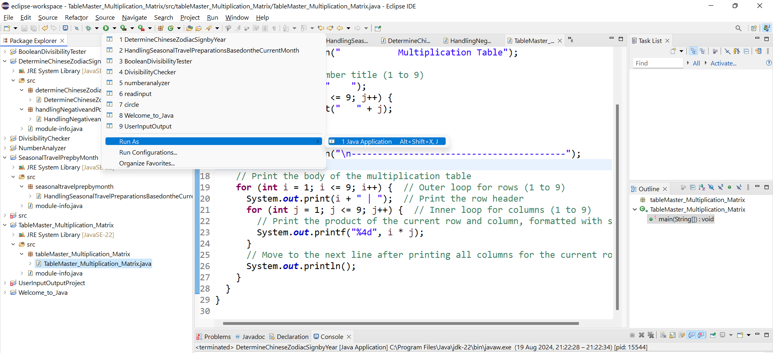
C:\Users\...\eclipse-workspace\TableMaster_Multiplication_Matrix\src\tableMaster_Multiplication_Matrix
This program uses nested for loops to systematically generate and display a 9x9 multiplication table. The outer loop handles the rows, while the inner loop handles the columns. Each cell in the table is the product of the row and column indices, and the output is formatted to ensure the table is aligned neatly.

Slide 54
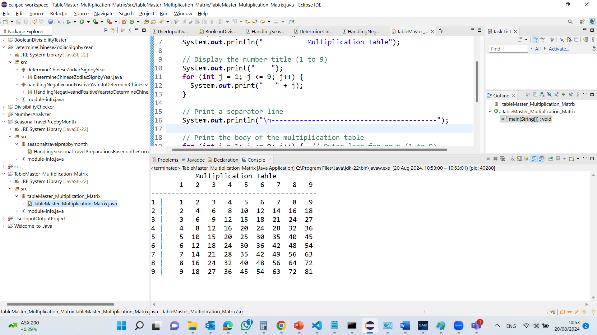
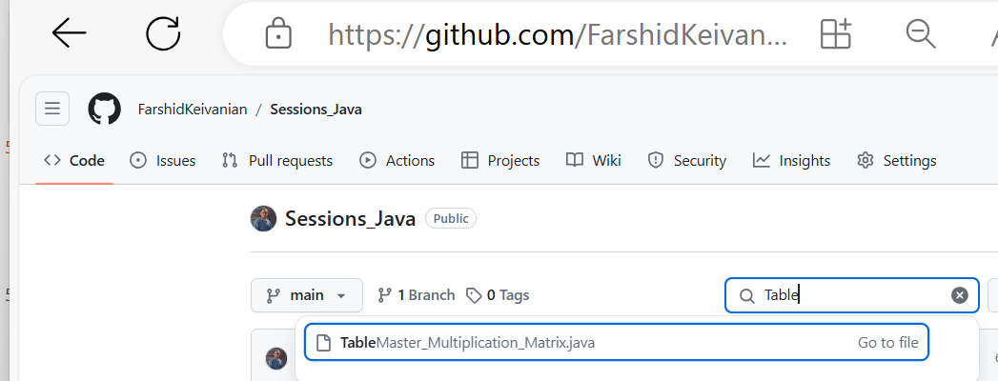

Slide 55
Using break and continue
Conditional Summing Up Numbers Examples with using the break and continue keywords:
TestBreak.java
TestBreak
TestContinue.java
TestContinue

Slide 56
break
Loop Iteration: The while loop continues to execute as long as number is less than 20.
Incrementing number: On each iteration, number is incremented by 1 (number++)

Slide 57
break
Summation: The value of number is added to sum on each iteration (sum += number).
Condition Check: The if statement checks if sum is greater than or equal to 100.
If sum is 100 or more, the break statement is executed.
The break statement immediately exits the loop, even if the loop condition (number < 20) is still true.

Slide 58
break
Post-Loop Output: After the loop is exited (either by the break statement or because number reaches 20), the program prints the value of number and sum

Slide 59
break
In this code, the break statement is used to exit the loop as soon as the sum of the numbers reaches or exceeds 100. This means the loop will not continue to increment number or add to sum once this condition is met.

Slide 60
break
Summary. The break statement is a control flow statement that is used to terminate a loop prematurely. In this example, it stops the loop when sum becomes 100 or greater, even though the loop's original condition (number < 20) might still be true. This is useful when you need to exit a loop as soon as a certain condition is met, which can help in improving efficiency and preventing unnecessary iterations.

Slide 61
continue
Condition Check: The if statement checks if number is equal to 10 or 11.
If number is 10 or 11, the continue statement is executed.
The continue statement causes the loop to skip the rest of the code inside the loop for that iteration, meaning the line sum += number; will not be executed when number is 10 or 11.

Slide 62
continue
Summation: For all other values of number, the code sum += number; is executed, adding the current number to sum.
Printing the Result: After the loop finishes, the total sum is printed.

Slide 63
continue
The continue statement is used to skip the current iteration of the loop when certain conditions are met, allowing the program to continue with the next iteration without executing the remaining code in the loop body for that iteration. In this example, it prevents 10 and 11 from being included in the total sum.

Slide 64
Problem: Guessing Numbers
Write a program that randomly generates an integer between 0 and 100, inclusive. The program prompts the user to enter a number continuously until the number matches the randomly generated number. For each user input, the program tells the user whether the input is too low or too high, so the user can choose the next input intelligently.
GuessNumberOneTime
GuessNumber
GuessNumberUsingBreak

Slide 65
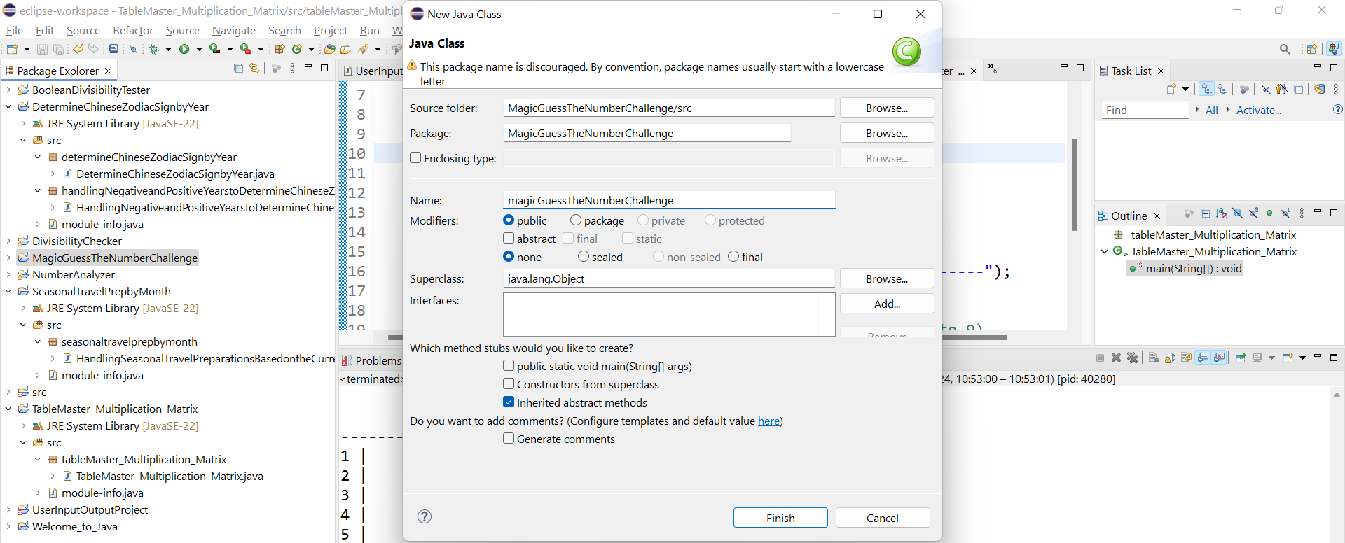
MagicGuessTheNumberChallenge

Slide 66
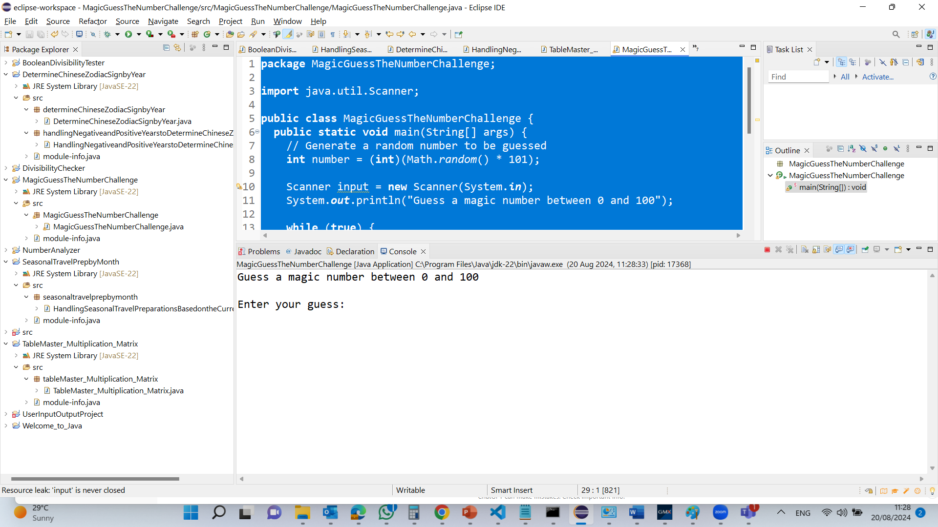
MagicGuessTheNumberChallenge

Slide 67
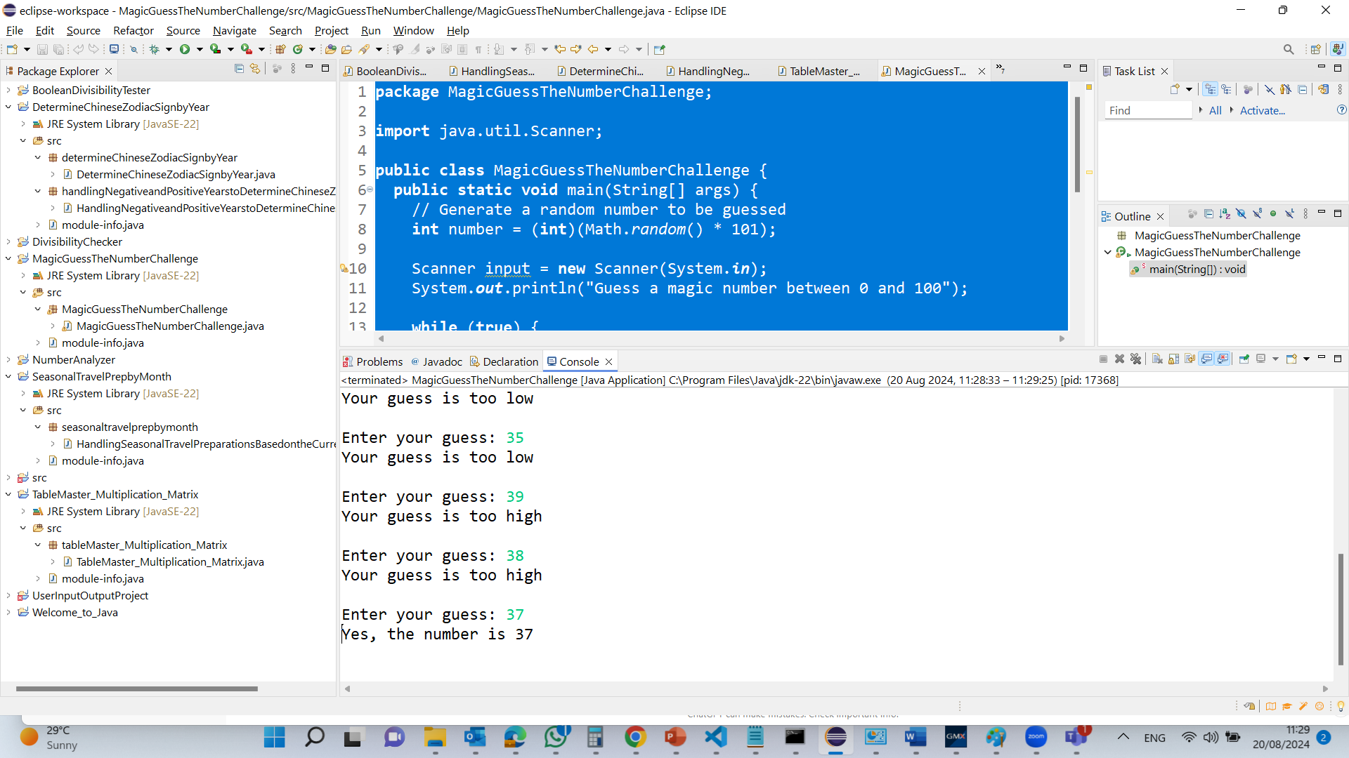
MagicGuessTheNumberChallenge

Slide 68
package MagicGuessTheNumberChallenge;
import java.util.Scanner;
public class MagicGuessTheNumberChallenge {
public static void main(String[] args) {
// Generate a random number to be guessed
int number = (int)(Math.random() * 101);
Scanner input = new Scanner(System.in);
System.out.println("Guess a magic number between 0 and 100");
while (true) {
// Prompt the user to guess the number
System.out.print("\nEnter your guess: ");
int guess = input.nextInt();
if (guess == number) {
System.out.println("Yes, the number is " + number);
break;
}
else if (guess > number)
System.out.println("Your guess is too high");
else
System.out.println("Your guess is too low");
} // End of loop
}
}
The main method is the entry point of any Java program. The Java Virtual Machine (JVM) calls this method to start the program. It is static because it can be called without creating an instance of the class.

Slide 69
package MagicGuessTheNumberChallenge;
import java.util.Scanner;
public class MagicGuessTheNumberChallenge {
public static void main(String[] args) {
// Generate a random number to be guessed
int number = (int)(Math.random() * 101);
Scanner input = new Scanner(System.in);
System.out.println("Guess a magic number between 0 and 100");
while (true) {
// Prompt the user to guess the number
System.out.print("\nEnter your guess: ");
int guess = input.nextInt();
if (guess == number) {
System.out.println("Yes, the number is " + number);
break;
}
else if (guess > number)
System.out.println("Your guess is too high");
else
System.out.println("Your guess is too low");
} // End of loop
}
}
This line generates a random integer between 0 and 100 (inclusive). Math.random() generates a double between 0.0 and 1.0. Multiplying by 101 scales this to the range 0.0 to 100.9999. The (int) cast truncates the decimal part, resulting in an integer.

Slide 70
package MagicGuessTheNumberChallenge;
import java.util.Scanner;
public class MagicGuessTheNumberChallenge {
public static void main(String[] args) {
// Generate a random number to be guessed
int number = (int)(Math.random() * 101);
Scanner input = new Scanner(System.in);
System.out.println("Guess a magic number between 0 and 100");
while (true) {
// Prompt the user to guess the number
System.out.print("\nEnter your guess: ");
int guess = input.nextInt();
if (guess == number) {
System.out.println("Yes, the number is " + number);
break;
}
else if (guess > number)
System.out.println("Your guess is too high");
else
System.out.println("Your guess is too low");
} // End of loop
}
}
This creates a Scanner object to read input from the standard input stream (System.in), usually the keyboard.

Slide 71
package MagicGuessTheNumberChallenge;
import java.util.Scanner;
public class MagicGuessTheNumberChallenge {
public static void main(String[] args) {
// Generate a random number to be guessed
int number = (int)(Math.random() * 101);
Scanner input = new Scanner(System.in);
System.out.println("Guess a magic number between 0 and 100");
while (true) {
// Prompt the user to guess the number
System.out.print("\nEnter your guess: ");
int guess = input.nextInt();
if (guess == number) {
System.out.println("Yes, the number is " + number);
break;
}
else if (guess > number)
System.out.println("Your guess is too high");
else
System.out.println("Your guess is too low");
} // End of loop
}
}
This line prints a message to the console, asking the user to guess a number between 0 and 100.

Slide 72
package MagicGuessTheNumberChallenge;
import java.util.Scanner;
public class MagicGuessTheNumberChallenge {
public static void main(String[] args) {
// Generate a random number to be guessed
int number = (int)(Math.random() * 101);
Scanner input = new Scanner(System.in);
System.out.println("Guess a magic number between 0 and 100");
while (true) {
// Prompt the user to guess the number
System.out.print("\nEnter your guess: ");
int guess = input.nextInt();
if (guess == number) {
System.out.println("Yes, the number is " + number);
break;
}
else if (guess > number)
System.out.println("Your guess is too high");
else
System.out.println("Your guess is too low");
} // End of loop
}
}
Infinite Loop for Gussing: This starts an infinite loop, which continues until a break statement is encountered.

Slide 73
package MagicGuessTheNumberChallenge;
import java.util.Scanner;
public class MagicGuessTheNumberChallenge {
public static void main(String[] args) {
// Generate a random number to be guessed
int number = (int)(Math.random() * 101);
Scanner input = new Scanner(System.in);
System.out.println("Guess a magic number between 0 and 100");
while (true) {
// Prompt the user to guess the number
System.out.print("\nEnter your guess: ");
int guess = input.nextInt();
if (guess == number) {
System.out.println("Yes, the number is " + number);
break;
}
else if (guess > number)
System.out.println("Your guess is too high");
else
System.out.println("Your guess is too low");
} // End of loop
}
}
Reading the User’s Guess: This prompts the user to enter their guess and reads it as an integer using the nextInt() method of the Scanner object.

Slide 74
package MagicGuessTheNumberChallenge;
import java.util.Scanner;
public class MagicGuessTheNumberChallenge {
public static void main(String[] args) {
// Generate a random number to be guessed
int number = (int)(Math.random() * 101);
Scanner input = new Scanner(System.in);
System.out.println("Guess a magic number between 0 and 100");
while (true) {
// Prompt the user to guess the number
System.out.print("\nEnter your guess: ");
int guess = input.nextInt();
if (guess == number) {
System.out.println("Yes, the number is " + number);
break;
}
else if (guess > number)
System.out.println("Your guess is too high");
else
System.out.println("Your guess is too low");
} // End of loop
}
}
Comparing the Guess with the Random Number: If the user's guess matches the random number, it prints a congratulatory message and exits the loop with the break statement.

Slide 75
package MagicGuessTheNumberChallenge;
import java.util.Scanner;
public class MagicGuessTheNumberChallenge {
public static void main(String[] args) {
// Generate a random number to be guessed
int number = (int)(Math.random() * 101);
Scanner input = new Scanner(System.in);
System.out.println("Guess a magic number between 0 and 100");
while (true) {
// Prompt the user to guess the number
System.out.print("\nEnter your guess: ");
int guess = input.nextInt();
if (guess == number) {
System.out.println("Yes, the number is " + number);
break;
}
else if (guess > number)
System.out.println("Your guess is too high");
else
System.out.println("Your guess is too low");
} // End of loop
}
}
Handling Incorrect Guesses: If the guess is higher than the random number, it informs the user that the guess is too high. If the guess is lower, it informs the user that the guess is too low. The loop then continues, prompting the user for another guess.

Slide 76
Mastering selections and loops?
Extremely important!
Practice, practice, practice…
More exercises in the labs.
Many more exercises in the textbook.

Slide 77
Thank You!
Happy A Learning Day!
Lecturer in IT
Dr. Farshid Keivanian

